Slide 1
Simulation
Where real stuff starts
Jean-Yves Le Boudec
2021

Slide 2
What is a simulation ?
Accuracy of output
Random Number Generators
How to sample
Monte Carlo

Slide 3
1. What is a simulation ?
Write your answer on this screen using Zoom’s menu
Annotate -> Text

Slide 4
What is a simulation ?
An experiment in computer
Important differences between simulation & real implementation
Serialization of events
Simulated vs real time
Initialization

Slide 5

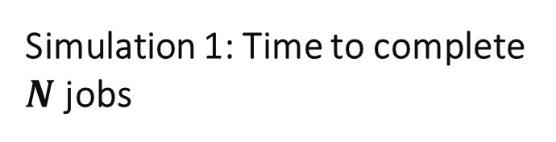
Two simulation examples. What is the difference ?
Simulation 1: Time to complete $N$ jobs
Simulation 2: Delay at a server
$N$ customers arrive (at the same time) at Joe’s shop and download a file. We want to estimate the time $T$ it takes to serve the $N$customers
An information server handles requests according to some scheduling policy. We want to estimate the time it takes to serve one request

Slide 6
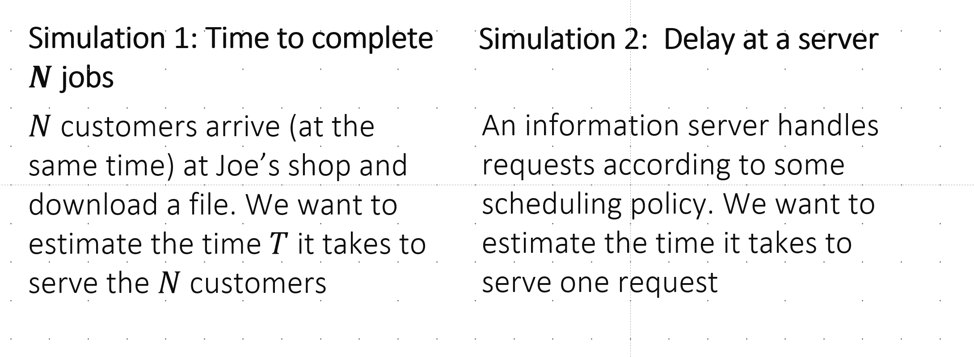
Terminating versus non-terminating simulation
This simulation terminates.
This simulation does not terminate
How long should we run it ?

Slide 7
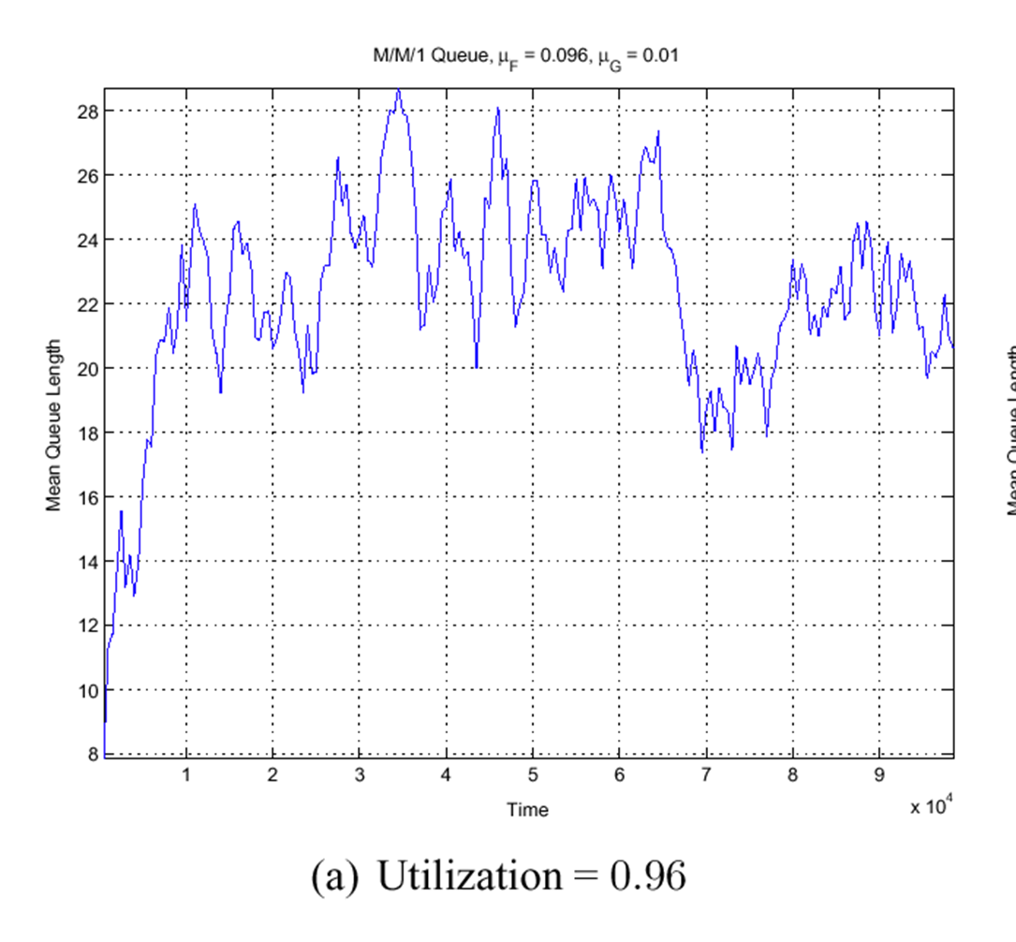
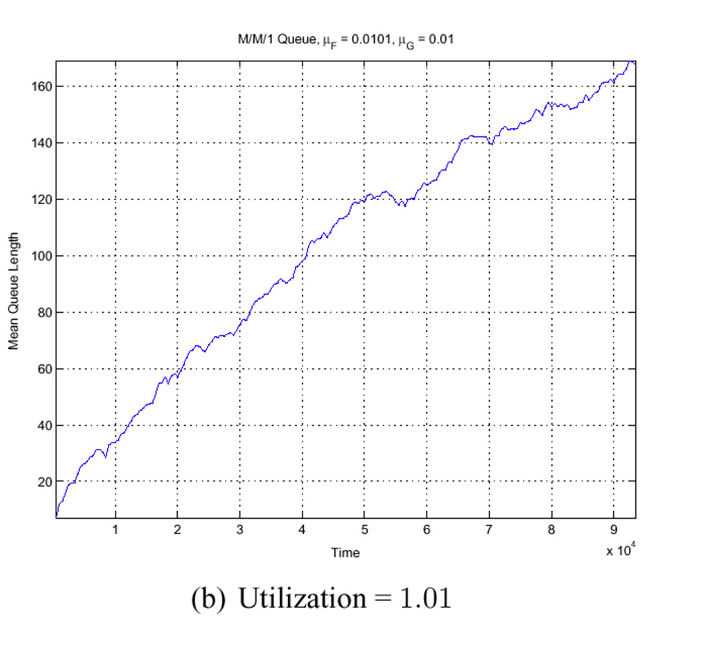
Two Simulation Runs What is the difference ?
Scenario 1
Scenario 2
Average service time = 96 ms
Average service time = 101 ms
Request arrival rate = 10 /s

Slide 8
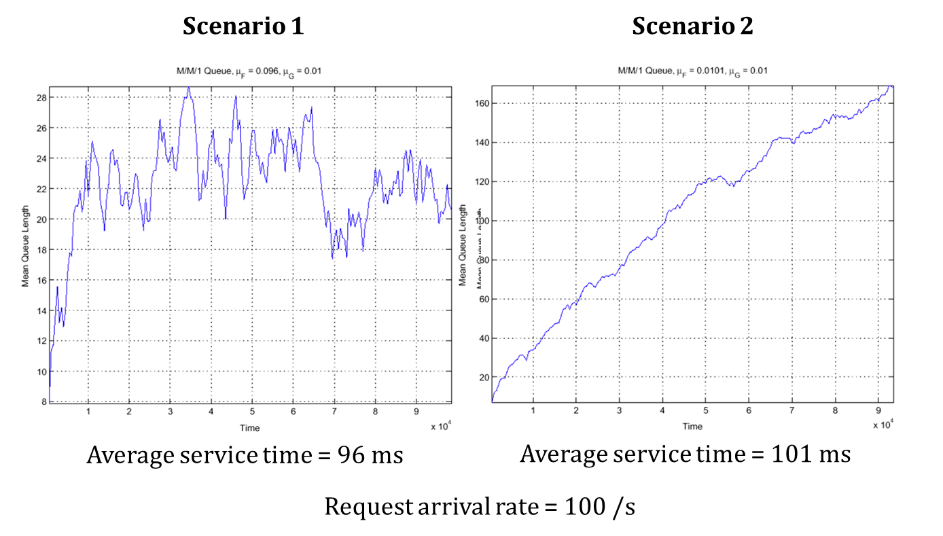
There is no stationary regime “walk to infinity”
10 /s
Transient phase due to atypical initial conditions followed by “typical” (=stationary) phase You want to measure things only in the stationary phase Otherwise: non reproducible results, non typical

Slide 9
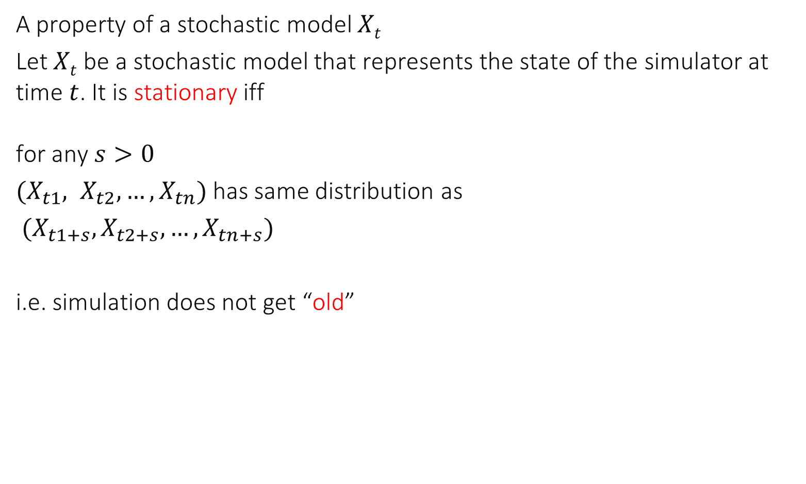
Definition of Stationarity
A property of a stochastic model $Xt$
Let $Xt$ be a stochastic model that represents the state of the simulator at time $t$. It is stationary iff for any $s>0$
$(X_{t1}, X_{t2},…,X_{tn})$ has same distribution as
$(X_{t1+s}, X_{t2+s}, …, X_{tn+s})$
i.e. simulation does not get “old”

Slide 10
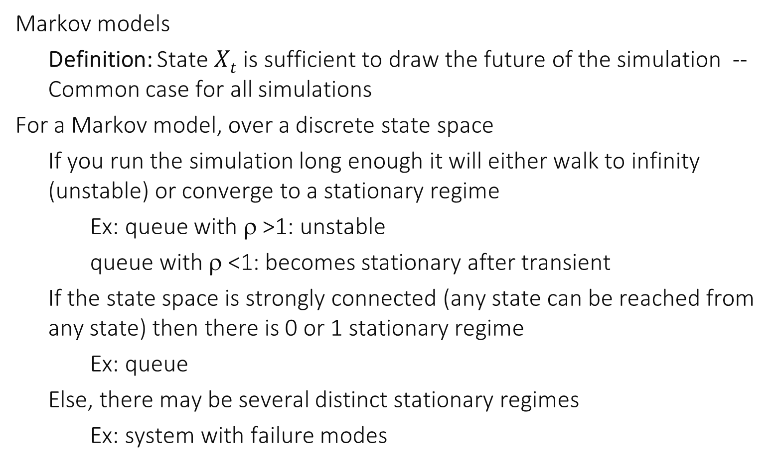
Classical Cases
Markov models
Definition: State $Xt$ is sufficient to draw the future of the simulation -- Common case for all simulations
For a Markov model, over a discrete state space
If you run the simulation long enough it will either walk to infinity (unstable) or converge to a stationary regime
Ex: queue with ρ >1: unstable
queue with ρ <1: becomes stationary after transient
If the state space is strongly connected (any state can be reached from any state) then there is 0 or 1 stationary regime
Ex: queue
Else, there may be several distinct stationary regimes
Ex: system with failure modes

Slide 11
Stationarity and Transience
Knowing whether a model has a stationary regime is sometimes a hard problem
We will see important models where this is solved
Ex: some queuing systems Ex: time series models
Reasoning about your system may give you indications
Do you expect growth ?
Do you expect seasonality ?
Once you believe your model is stationary, you should handle transients in order to eliminate the impact of initial conditions
Remove (how ? Look at your output and guess)
Sometimes it is possible to avoid transients at all (perfect simulation – see later “Importance of the View Point”)

Slide 12
Typical Reasons For Non Stationarity
Obvious dependency on time
Seasonality, growth
Can be ignored at small time scale (minute)
Non Stability: Explosion
Queue with utilization factor >1
Non Stability: Freezing Simulation
System becomes slower with time (aging)
Typically because there are rare events of large impact (« Kings ») The longer the simulation, the larger the largest king
We’ll come back to this in the chapter « Importance of the View Point »

Slide 13
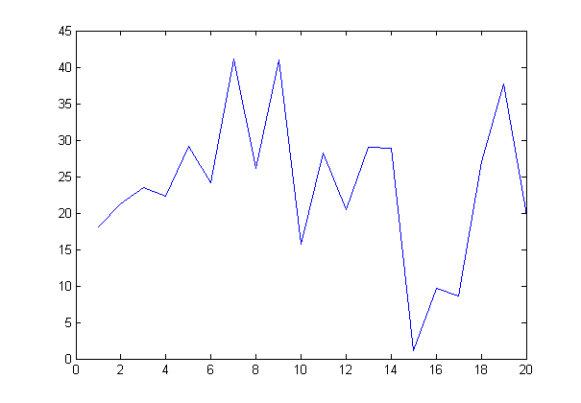
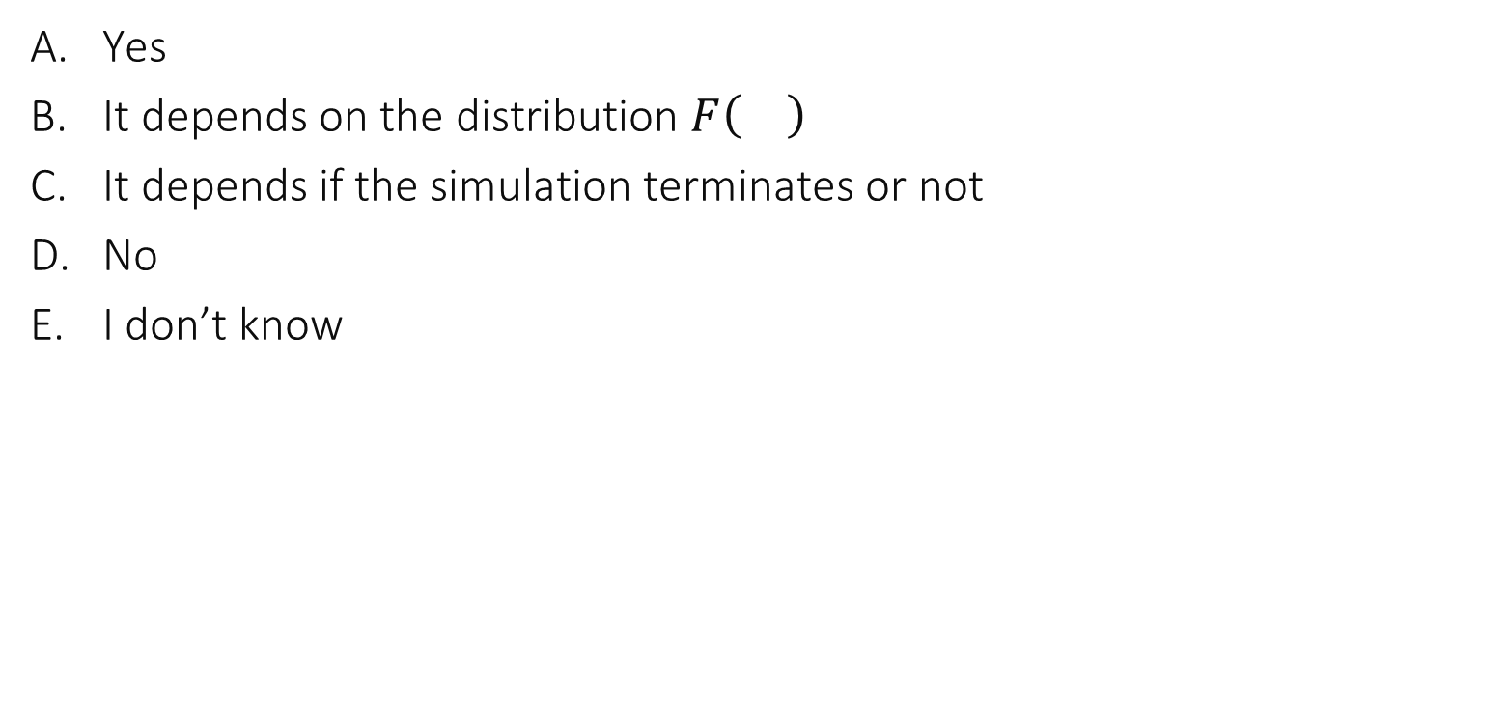
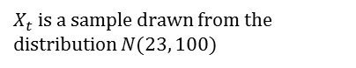

The state of a simulation at time $t=1,2,3,…$ is drawn at random from a distribution F(). Is this a stationary simulation ?
Yes
It depends on the distribution $F\left(\right)$
It depends if the simulation terminates or not
No
I don’t know
$X_{t}$ is a sample drawn from the distribution $N(23, 100)$

Slide 14
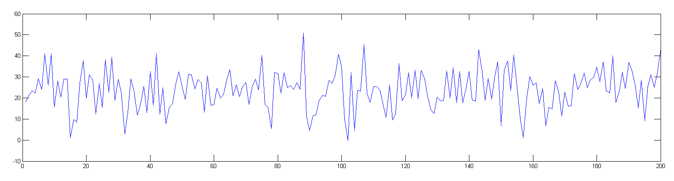
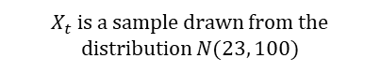
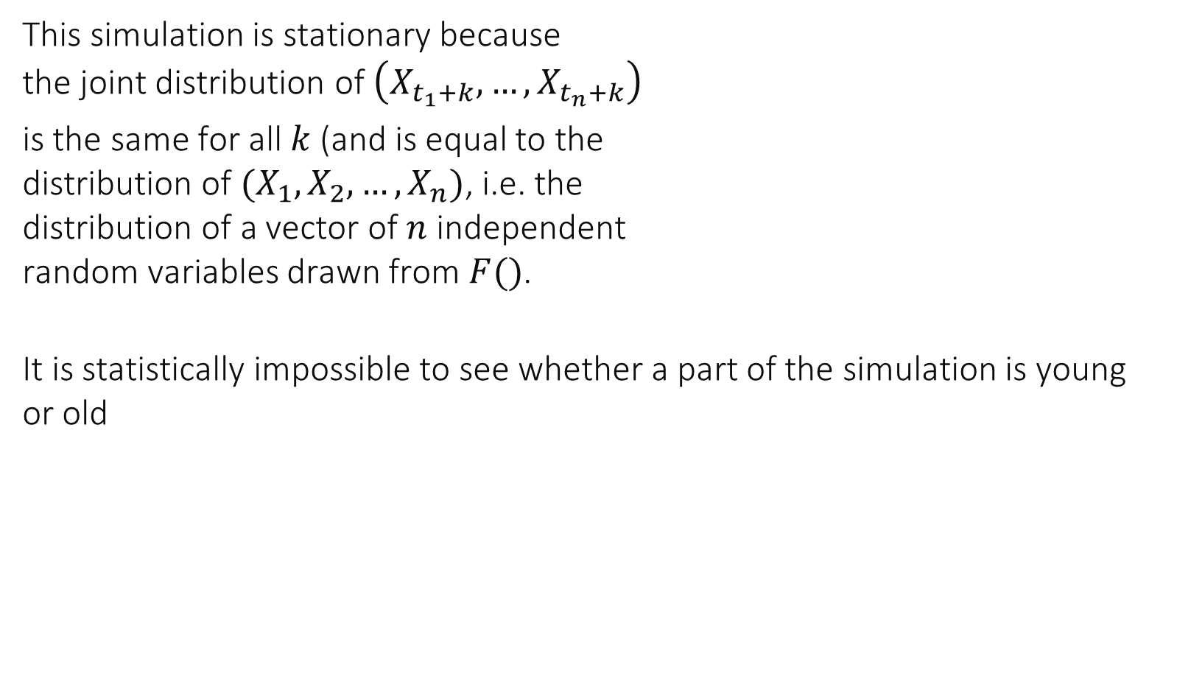
This simulation is stationary because the joint distribution of $\left(X_{t_{1}+k},…,X_{t_{n}+k}\right)$
is the same for all $k$ (and is equal to the distribution of $(X_{1},X_{2},…,X_{n})$, i.e. the distribution of a vector of $n$ independent random variables drawn from $F()$.
It is statistically impossible to see whether a part of the simulation is young or old
$X_{t}$ is a sample drawn from the distribution $N(23, 100)$

Slide 15
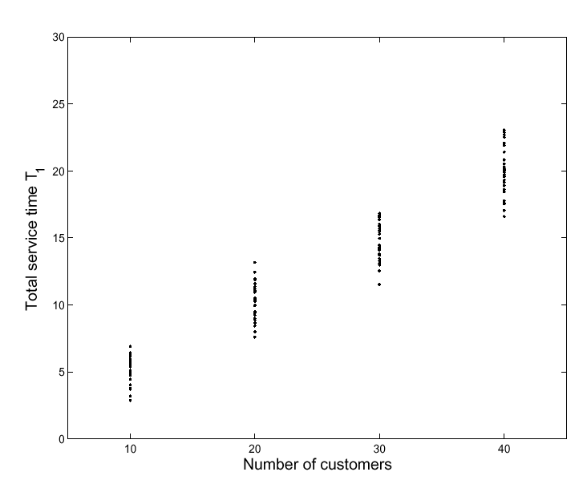
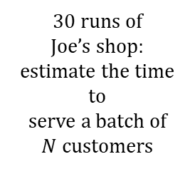
2 Accuracy of Simulation Output
Deterministic vs Stochastic Simulation
A stochastic simulation produces a random output, we need confidence intervals
Use Replication
30 runs of
Joe’s shop: estimate the time to serve a batch of $N$customers

Slide 16
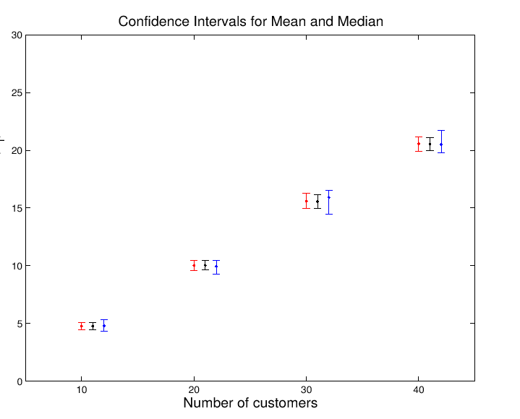
Confidence Intervals
Median
Mean

Slide 17
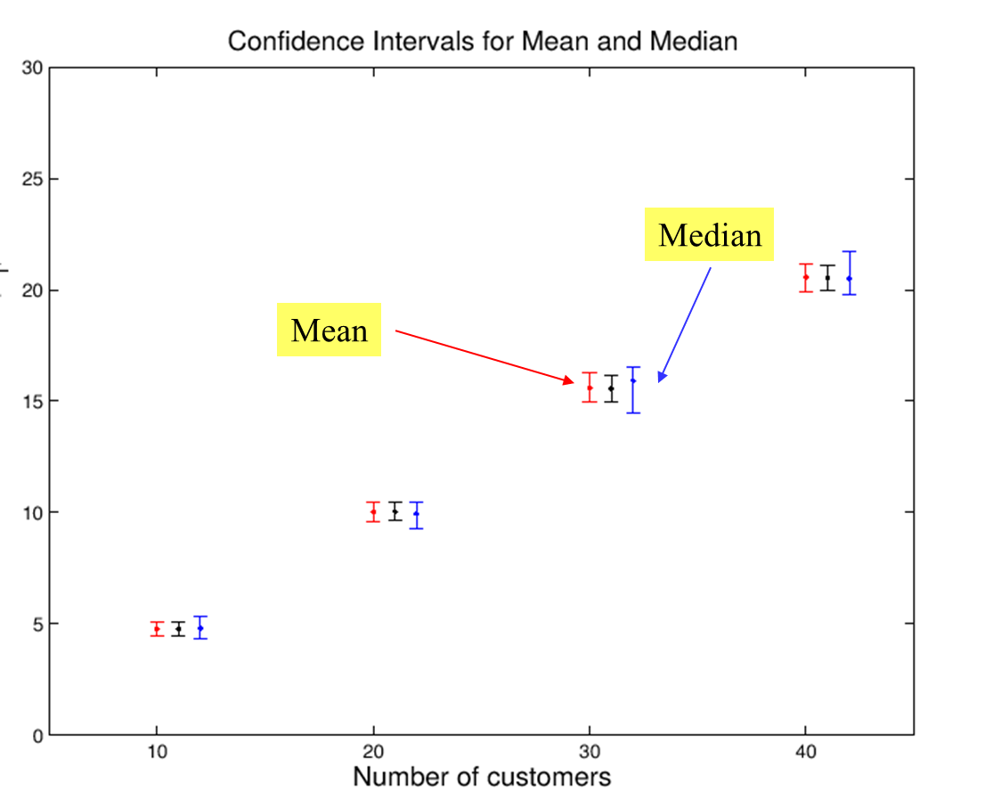
When computing these confidence intervals we need to make sure that…
… the simulation runs are independent
… the output is normally distributed
Both
None
I don’t know

Slide 18
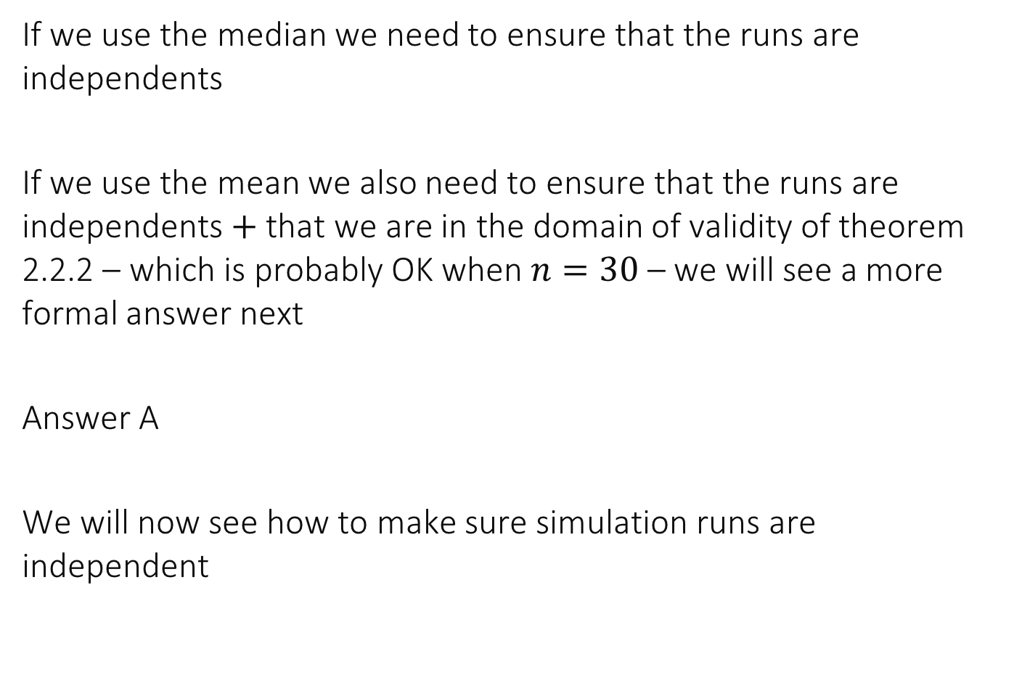
Solution
If we use the median we need to ensure that the runs are independents
If we use the mean we also need to ensure that the runs are independents $+$ that we are in the domain of validity of theorem 2.2.2 – which is probably OK when $n=30$ – we will see a more formal answer next
Answer A
We will now see how to make sure simulation runs are independent

Slide 19
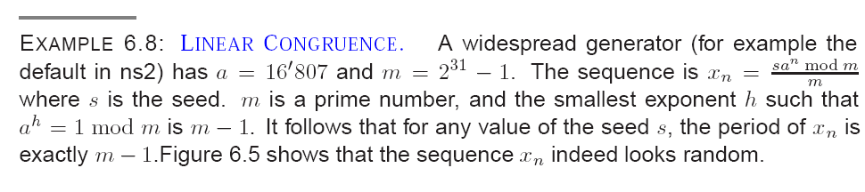
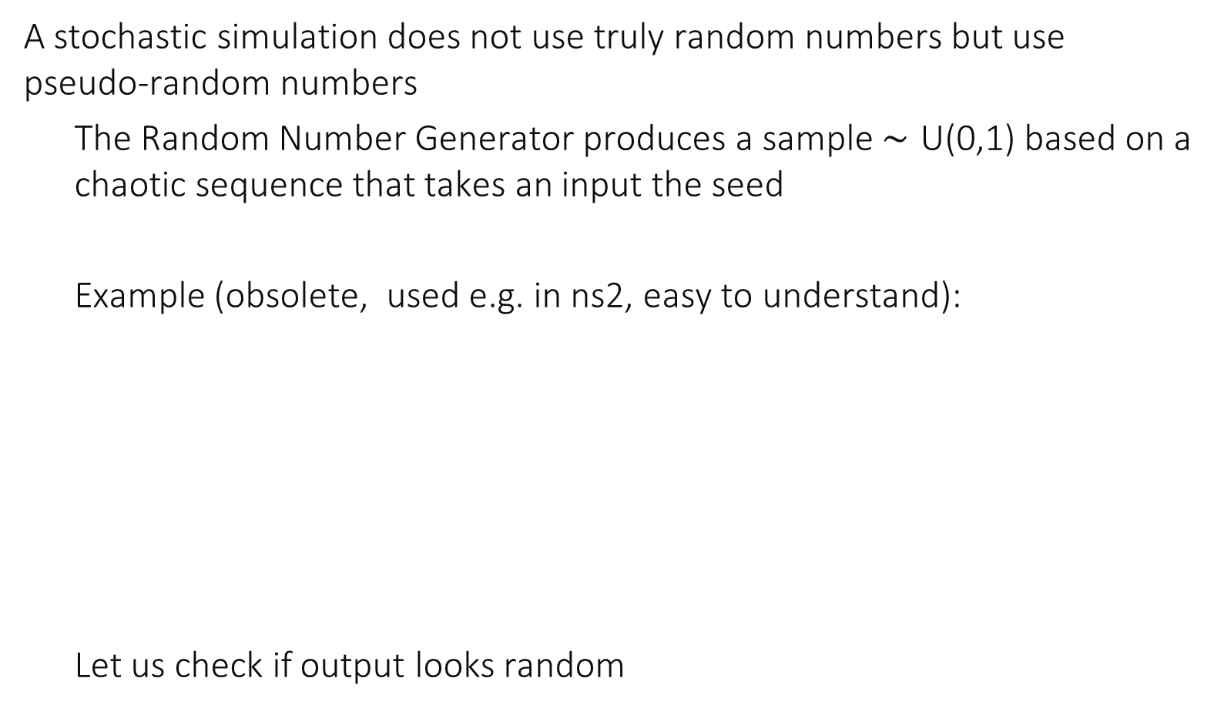
3 Random Number Generator
A stochastic simulation does not use truly random numbers but use pseudo-random numbers
The Random Number Generator produces a sample $∼\text{U}\text{(0,1)}$ based on a chaotic sequence that takes an input the seed
Example (obsolete, used e.g. in ns2, easy to understand): Let us check if output looks random

Slide 20
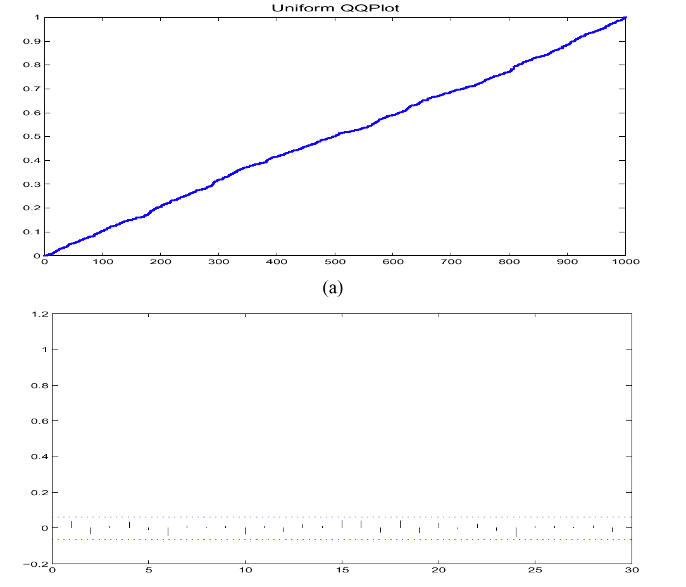
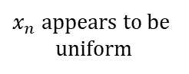
The Linear Congruential Generator of ns2
uniform qq plot
$x_{n}$ appears to be uniform
Auto-correlation is
negligible
autocorrelation

Slide 21
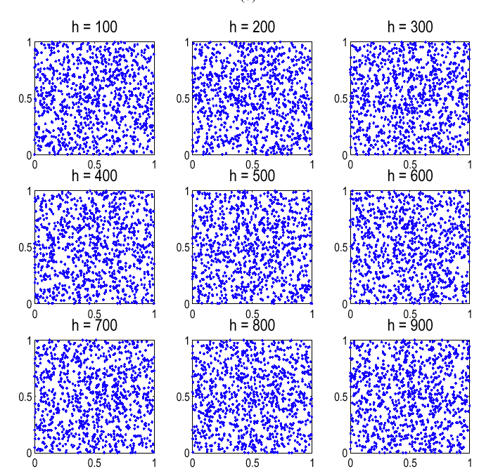
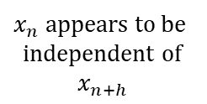

Lag Diagram $\left(x_{n}, x_{n+h}\right)$, 1000 points
$x_{n}$ appears to be independent of $$x_{n+h}$$

Slide 22
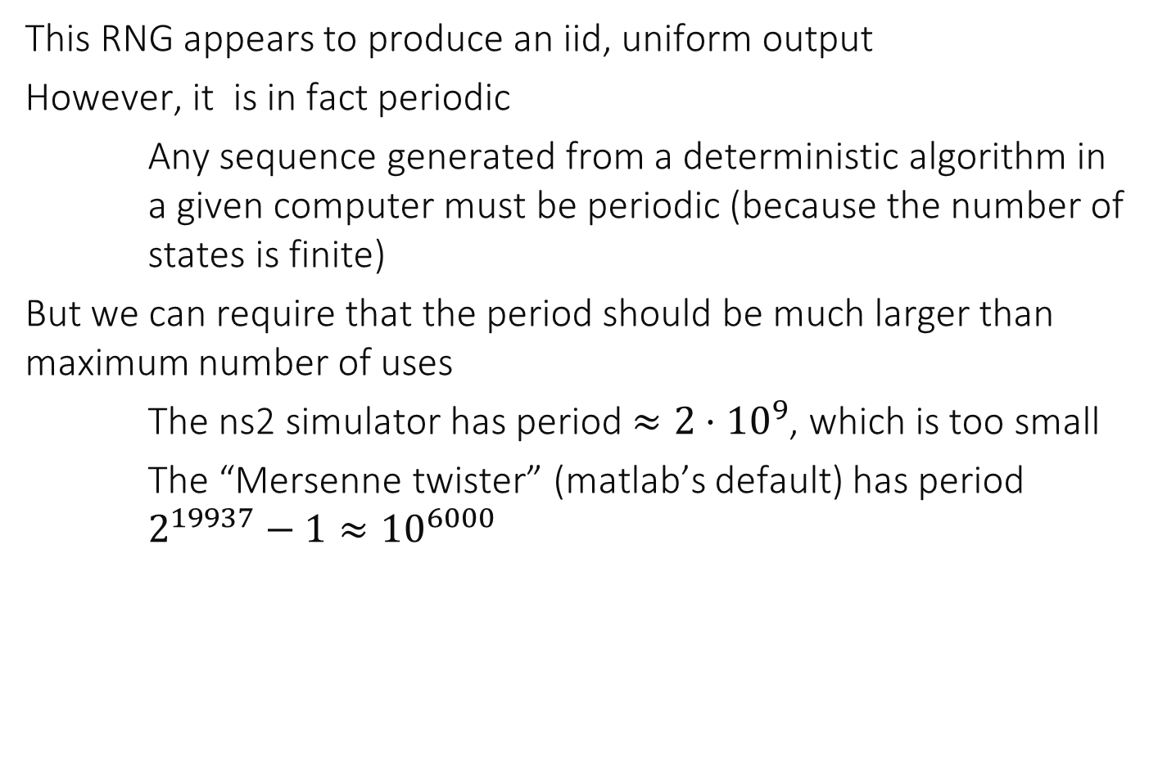
Period of RNG
This RNG appears to produce an iid, uniform output
However, it is in fact periodic
Any sequence generated from a deterministic algorithm in a given computer must be periodic (because the number of states is finite)
But we can require that the period should be much larger than maximum number of uses
The ns2 simulator has period $≈2⋅{10}^{9}$, which is too small
The “Mersenne twister” (matlab’s default) has period $2^{19937}−1≈{10}^{6000}$

Slide 23
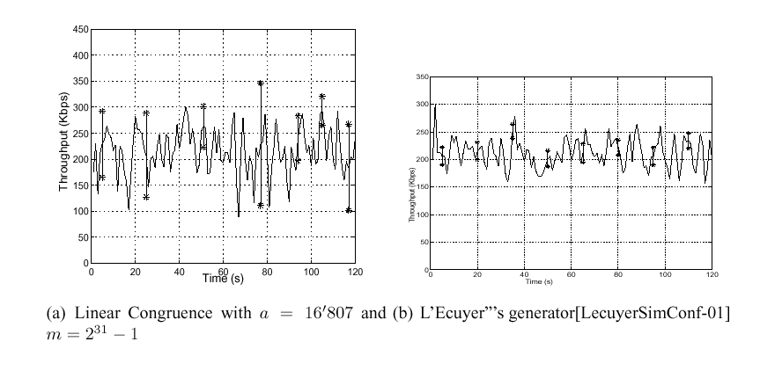
Example when the period is too small
Correct intervals
Incorrect intervals (too large)

Slide 24
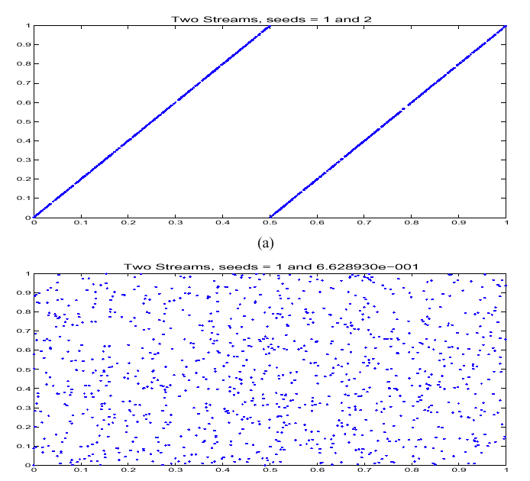
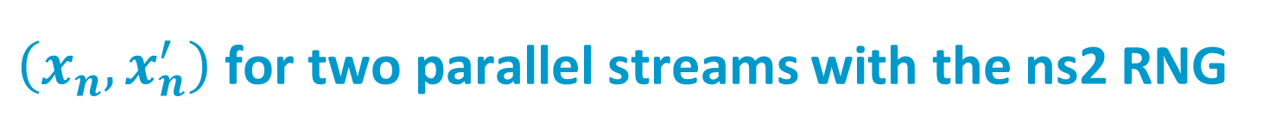
$\left(x_{n}, x_{n}^{′}\right)$ for two parallel streams with the ns2 RNG

Slide 25
Using RNGs
Be careful to have a RNG that has a period orders of magnitude larger than what you will ever use in the simulation – choose your RNG carefully
The RNG must have a period several orders of magnitude larger than the maximum number of times you will call it
The RNG uses a seed -- for independent replications you need independent seeds; sequential runs usually are sufficient. If you use parallel runs, you must find an way to obtain truly independent seeds
E.g. based on the clock of the computer
Or based on inputs by the user
Or based on random.org
Or by using an RNG that supports parallel streams

Slide 26
Special RNGs for Independent Parallel Streams
Matlab example
[s1,s2,s3,s4]=RandStream.create('mlfg6331_64','NumStreams',4)
4 streams with the same seed and random generator that are however statistically independent
r1=rand(s1,100000,1);
r2=rand(s2,100000,1);
r3=rand(s3,100000,1);
r4=rand(s4,100000,1);
corrcoef([r1,r2,r3,r4])ans =
1.0000 0.0007 0.0052 -0.0030
0.0007 1.0000 0.0000 0.0031
0.0052 0.0000 1.0000 -0.0050
-0.0030 0.0031 -0.0050 1.0000

Slide 27
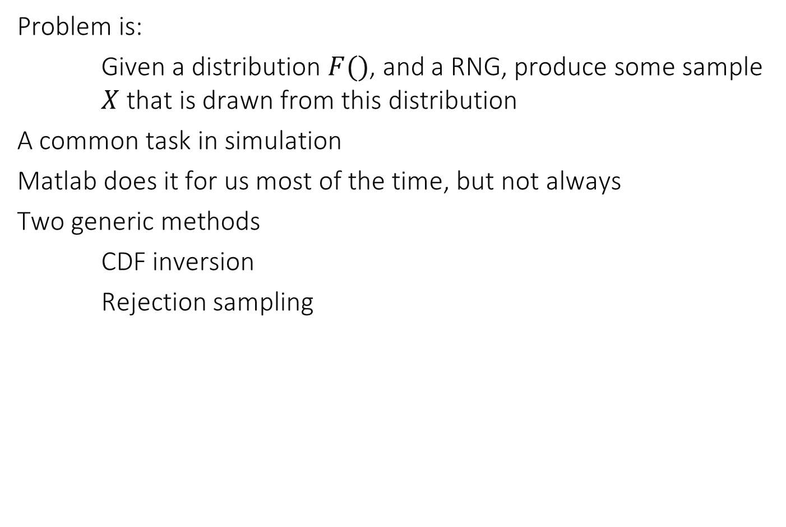
4 Sampling from a Distribution
Problem is:
Given a distribution $F()$, and a RNG, produce some sample $X$ that is drawn from this distribution
A common task in simulation
Matlab does it for us most of the time, but not always
Two generic methods
CDF inversion
Rejection sampling

Slide 28
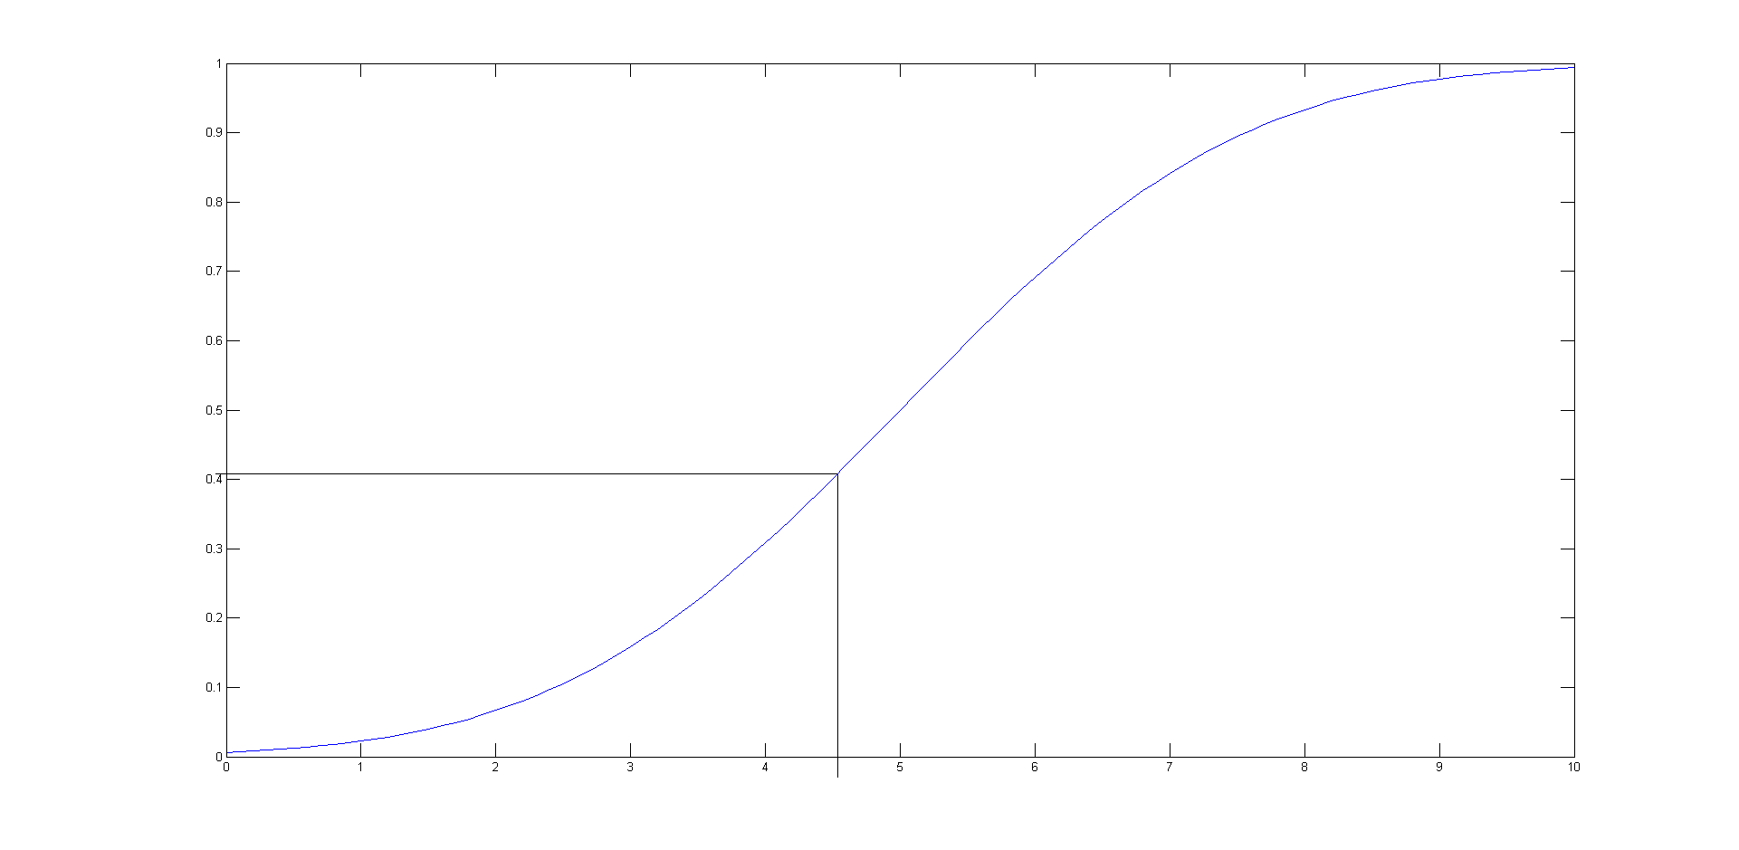
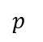
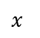

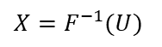

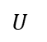
CDF Inversion for distribution with CDF $F()$
Applies to real or integer valued random variable
For a continuous distribution: draw $U∼U(0,1)$ using RNG; then $X=F^{−1}(U)$ is drawn from the distribution with CDF $F()$
$$p$$
CDF
$$U$$
$$X=F^{−1}(U)$$
$$x$$

Slide 29
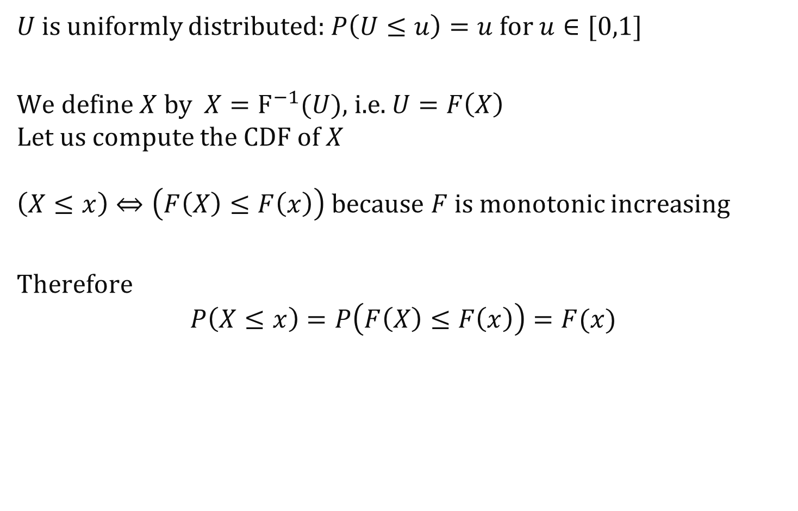
Proof
$U$ is uniformly distributed: $P\left(U≤u\right)=u$ for $u∈[0,1]$
We define $X$ by $X=F^{−1}(U)$, i.e. $U=F\left(X\right)$ Let us compute the CDF of $X$ $\left(X≤x\right)⇔\left(F\left(X\right)≤F\left(x\right)\right)$ because $F$ is monotonic increasing
Therefore
$$P\left(X≤x\right)=P\left(F\left(X\right)≤F\left(x\right)\right)=F(x)$$

Slide 30
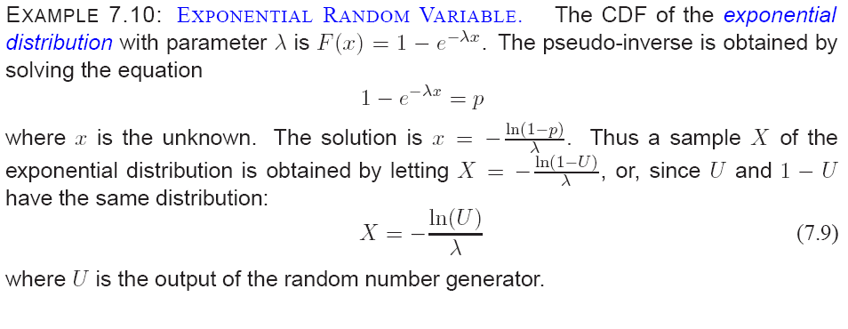

Slide 31
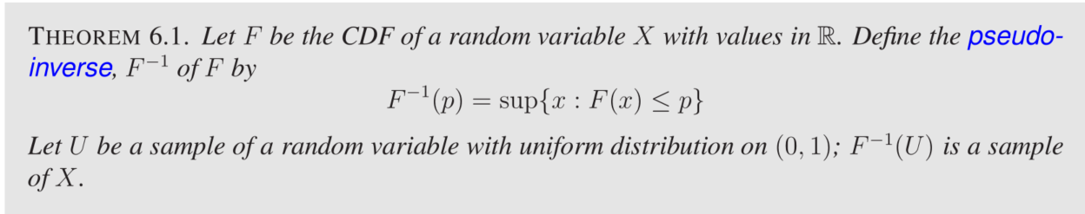
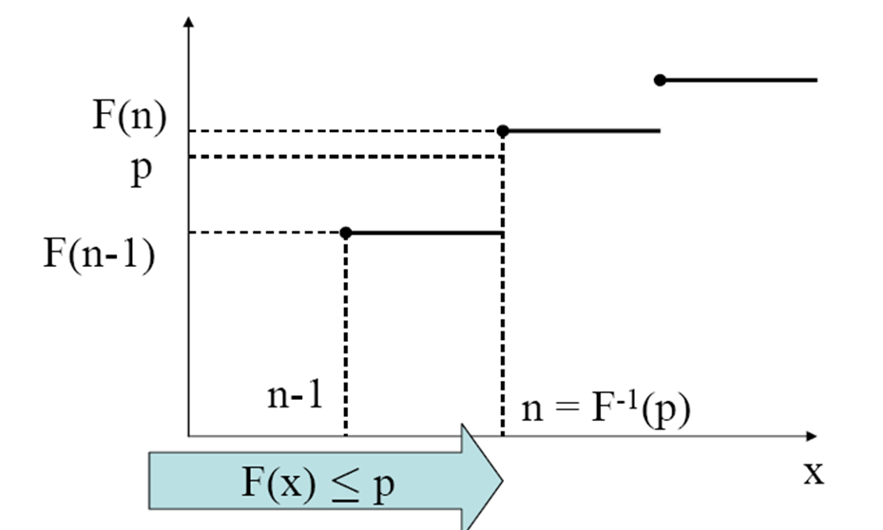

CDF Inversion, when $F()$ has jumps
Replace inverse by (upper) pseudo-inverse
CDF of an integer-valued random variable

Slide 32
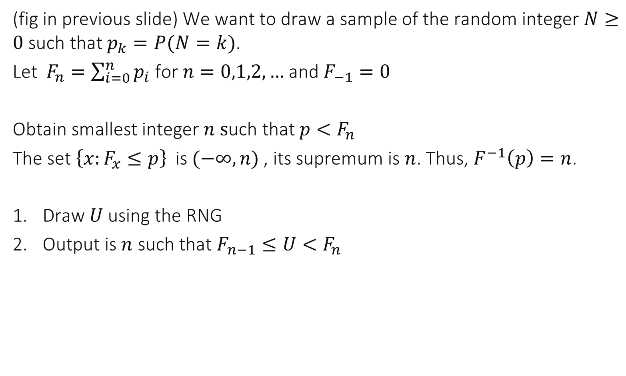
Sampling an integer valued RV
(fig in previous slide) We want to draw a sample of the random integer $N≥0$such that $p_{k}=P(N=k)$.
Let $F_{n}=\sum_{i=0}^{n}{p_{i}}$ for $n=0,1,2,…$and $F_{−1}=0$
Obtain smallest integer $n s$uch that ${p<F}_{n}$
The set ${\left\{x:F_{x}≤p\right\}}_{ }$is ${(−∞, n)}_{ }$, its supremum is $n$. Thus, $F^{−1}\left(p\right)=n$.
Draw $U$ using the RNG
Output is $n$ such that $F_{n−1}≤U<F_{n}$

Slide 33
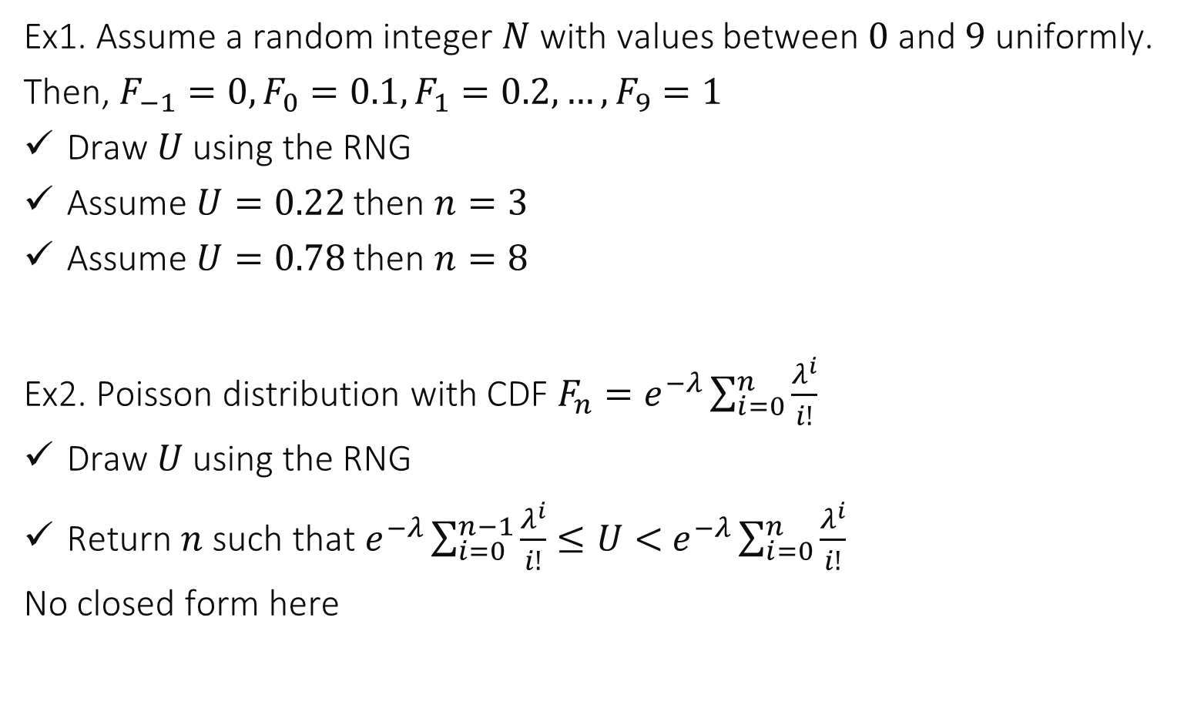
Examples
Ex1. Assume a random integer $N$ with values between $0$ and $9$ uniformly.
Then, $F_{−1}=0, F_{0}=0.1, F_{1}=0.2, …, F_{9}=1$
Draw $U$using the RNG
Assume $U=0.22$ then $n=3$
Assume $U=0.78$ then $n=8$
Ex2. Poisson distribution with CDF ${F_{n}=e}^{−λ}\sum_{i=0}^{n}{\frac{λ^{i}}{i!}}$
Draw $U$using the RNG
Return $n$ such that $e^{−λ}\sum_{i=0}^{n−1}{\frac{λ^{i}}{i!}≤U<}$ $e^{−λ}\sum_{i=0}^{n}{\frac{λ^{i}}{i!}}$
No closed form here

Slide 34
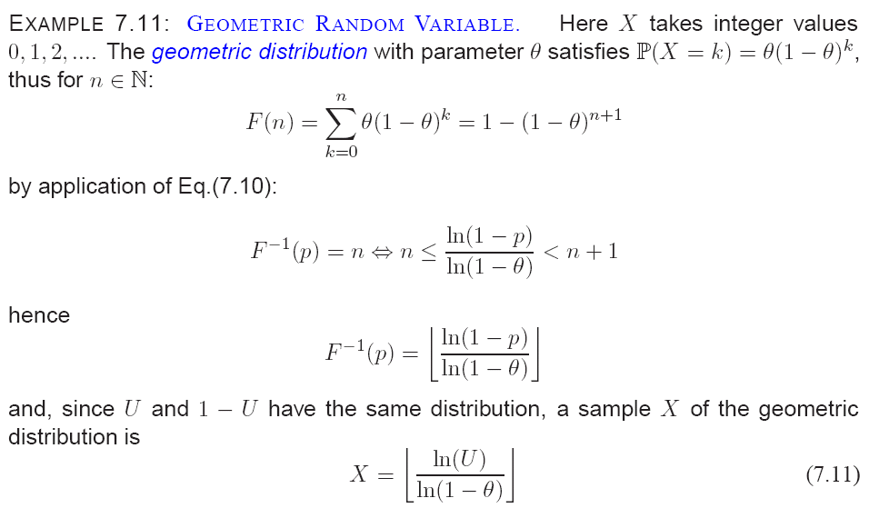

Slide 35
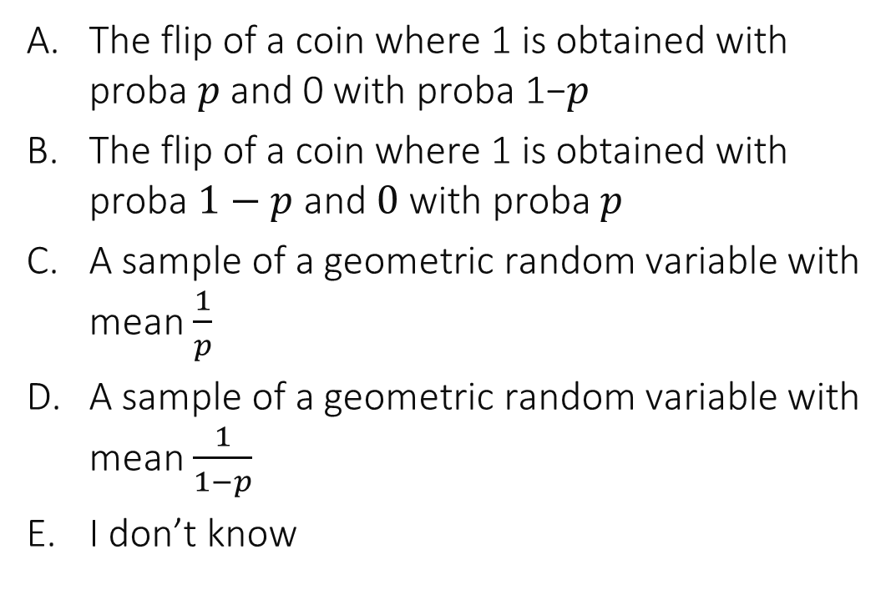

What does this function compute ? myfun$\left(p\right)=$ if rand$()<p$ 0 else 1
The flip of a coin where 1 is obtained with proba 𝑝 and 0 with proba 1−𝑝
The flip of a coin where 1 is obtained with proba $1−p$ and $0$ with proba $p$
A sample of a geometric random variable with mean $\frac{1}{p}$
A sample of a geometric random variable with mean $\frac{1}{1−p}$
I don’t know

Slide 36
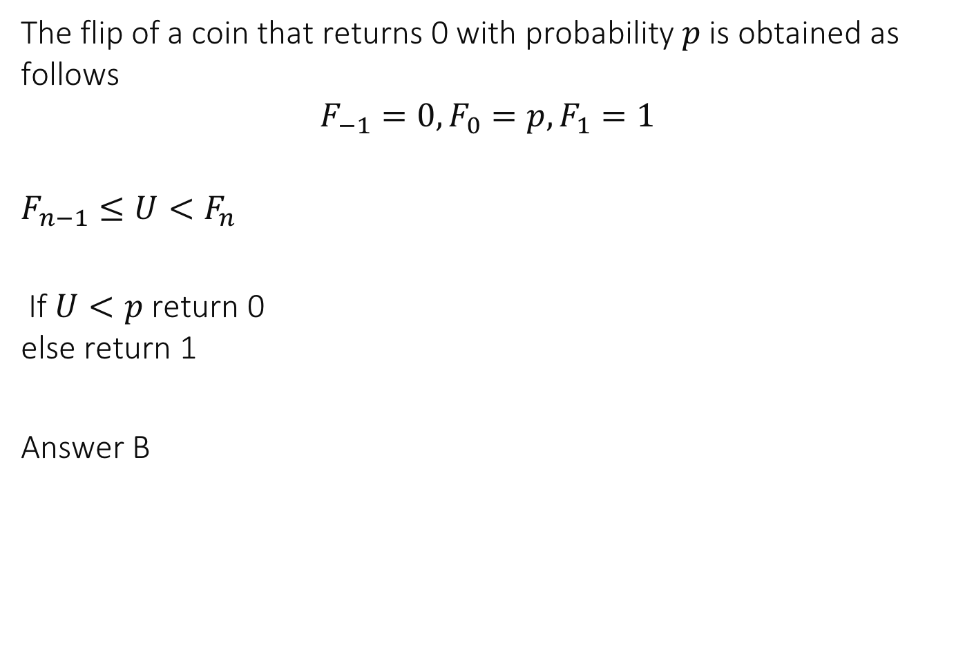
Solution
The flip of a coin that returns 0 with probability $p$ is obtained as follows
$$F_{−1}=0, F_{0}=p, F_{1}=1$$
$$F_{n−1}≤U<F_{n}$$
If $U<p$ return 0 else return 1
Answer B

Slide 37
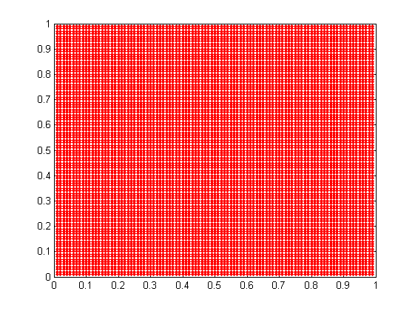
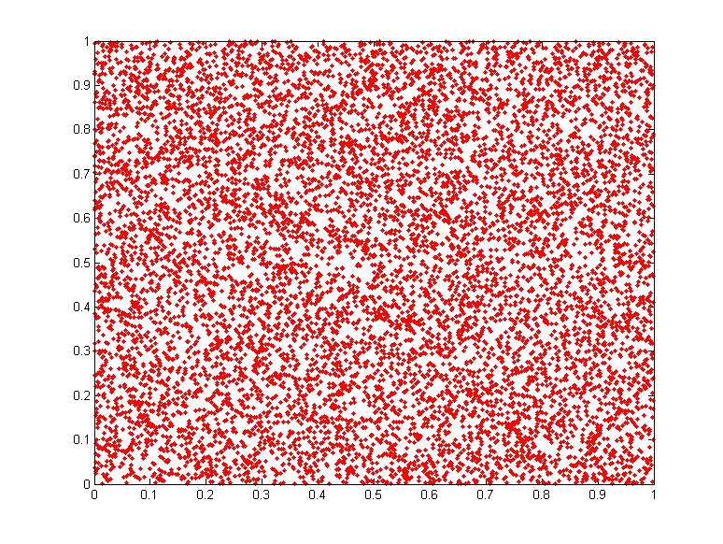
Which one is a uniform random point ?
10’000 samples
A
B
Both
None
I don’t know
A
B

Slide 38
Solution
A is a regular (non random) sample
B is sampled from the uniform distribution
Answer B
A
B

Slide 39
How do you sample a random uniform point in a rectangle ?

Slide 40
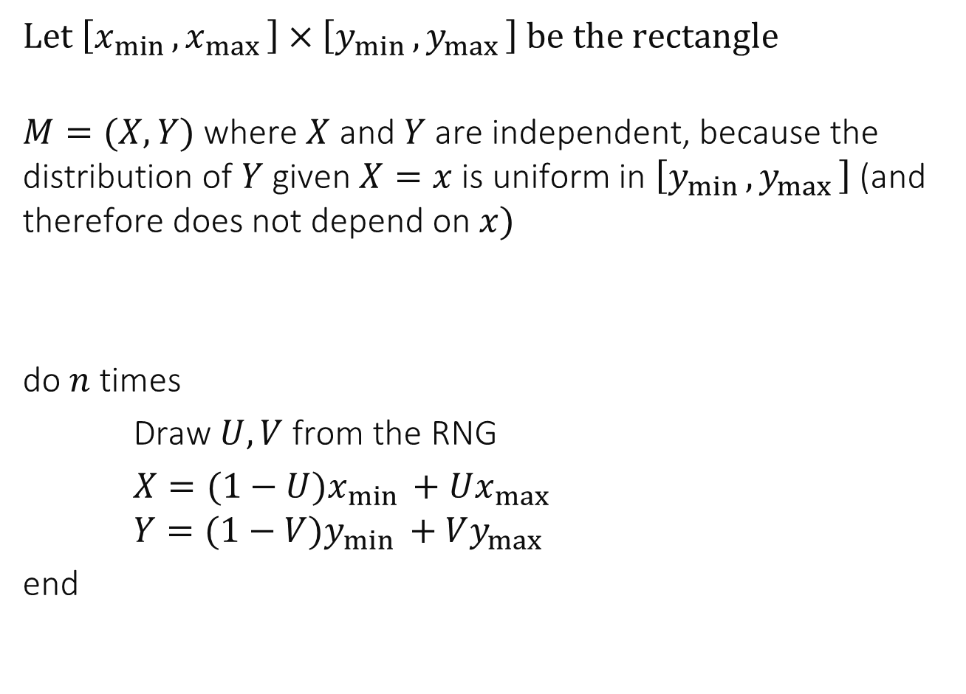
How do you sample a uniform point in a rectangle ?
Let $\left[x_{min },x_{max }\right]×\left[y_{min },y_{max }\right]$ be the rectangle
$M=(X,Y)$ where $X$ and $Y$ are independent, because the distribution of $Y$ given $X=x$ is uniform in $\left[y_{min },y_{max }\right]$ (and therefore does not depend on $x)$
do $n$ times
Draw $U,V$ from the RNG
$X=(1−U)x_{min }+Ux_{max }$ $Y=(1−V)y_{min }+Vy_{max }$
end

Slide 41
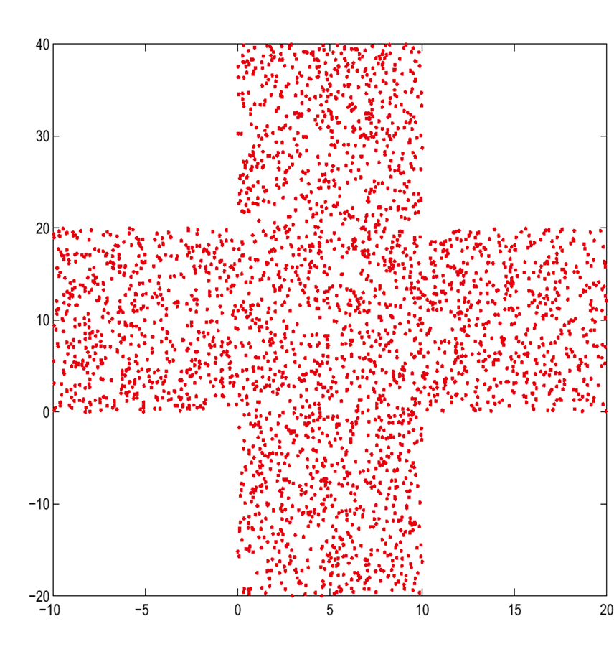

We sample a point $M=\left(X,Y\right)$uniformly in some arbitrary area. Are $X$ and $Y$ independent ?
Yes
It depends on the area
No
I don’t know

Slide 42
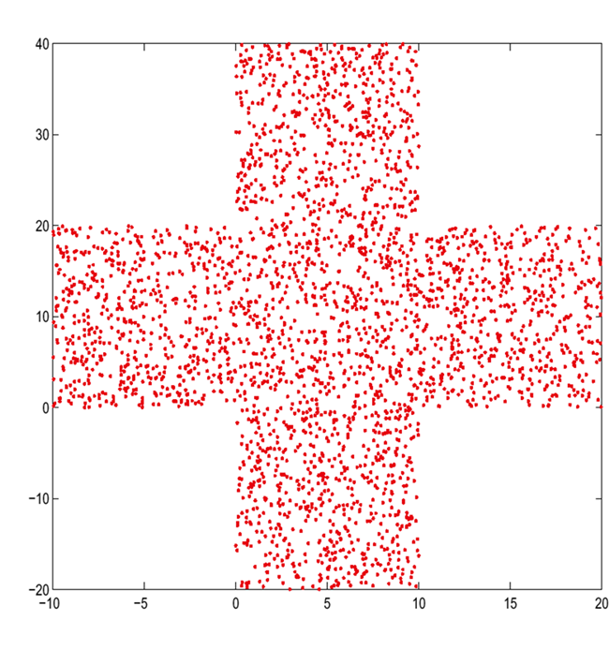
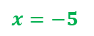
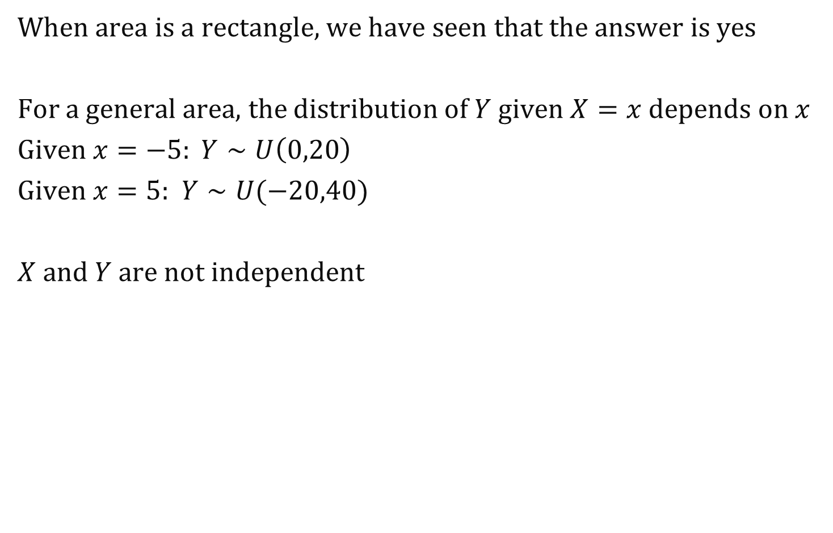

Solution
When area is a rectangle, we have seen that the answer is yes
For a general area, the distribution of $Y$ given $X=x$ depends on $x$
Given $x=−5: Y∼U\left(0,20\right)$
Given $x=5:$ $Y∼U(−20,40)$
$X and Y$ are not independent
$$x=−5$$
$$x=5$$

Slide 43



What is the PDF of the uniform distribution in $A$ ?
$$area A$$
$f_{X,Y}\left(x,y\right)=\left\{\begin{aligned}1 \text{if} (x,y)∈A \\ 0 otherwise\end{aligned}\right.$
$f_{X,Y}\left(x,y\right)=\left\{\begin{aligned}xy \text{if} (x,y)∈A \\ 0 otherwise\end{aligned}\right.$
Something else
I don’t know

Slide 44


Solution
$$area A$$
Answer C
The pdf is constant on $A$(that is the
definition of uniform) and 0 outside A but the constant is such that the total probability is 1
$$f_{X,Y}\left(x,y\right)=\left\{\begin{aligned}\frac{1}{area(A)} \text{if} (x,y)∈A \\ 0 otherwise\end{aligned}\right.$$

Slide 45



How can we sample a point uniformly distributed in this area $A$?
A
draw $X∼U\left(−10,20\right)$ if $X∈[0;10]$ draw $Y∼U\left(−20;40\right]$ else draw $Y∼U\left(0;20\right]$
$$area A$$
B
repeat
draw $X∼U\left(−10,20\right),Y∼U\left(−20;40\right]$
until $\left(X,Y\right)∈A$
A
B
Both
None
I don’t know

Slide 46


Solution
$$area A$$
The correct $X$ is not uniformly distributed. It has a higher chance of falling in $[0;10]$
A is wrong

Slide 47


Solution
B
repeat
draw $X∼U\left(−10,20\right),Y∼U\left(−20;40\right]$
until $\left(X,Y\right)∈A$
$$area A$$
B first computes a point $(X,Y)$ that is
uniformly distributed and rejects it if it does not pass the test $\left(X,Y\right)∈A$
This is called rejection sampling
It produces a sample of the conditional distribution of $(X,Y)$ given that $\left(X,Y\right)∈A$ (theorem 6.2 – see later)

Slide 48


Solution
$$area A$$
B produces a sample of the conditional distribution of $(X,Y)$ given that $\left(X,Y\right)∈A$
What is this distribution ?
$$P\left(X∈\left[x, x+dx\right], Y∈[y, y+dy] | \left(X,Y\right)∈A\right)=\frac{P\left(X∈\left[x, x+dx\right], Y∈\left[y, y+dy\right] and \left(x,y\right)∈A\right)}{P(\left(X,Y\right)∈A)} \\ =\frac{1}{area(A)}×1_{(x,y)∈A}×dx dy$$
Thus the pdf is$f_{X,Y}\left(x,y\right)=1_{(x,y)∈A}×\frac{1}{area(A)}$ i.e. the uniform distribution.

Slide 49



Rejection Sampling for Conditional Distribution
Notation in this theorem | Previous example
$$\tilde{X}$$ | $\left(X,Y\right)∼Unif($ rectangle)
$$\tilde{Y}$$ | $\left(X,Y\right)∼Unif($ rectangle)
$$X$$ | $\left(X,Y\right)∼Unif($ A)
$$area A$$

Slide 50



Recap
$$area A$$
A uniformly distributed point in an area A has pdf equal to $f_{X,Y}\left(x,y\right)=1_{(x,y)∈A}×\frac{1}{area(A)}$
It can be sampled by rejection sampling sample a point $(X,Y)$ uniform in a bounding box around $A$ reject $\left(X,Y\right)$ if not in $A$
until $\left(X,Y\right)∈A$ return $(X,Y)$
Note: the distribution here is not the same as there

Slide 51

Example: Sampling a Uniform Random Point in Unit Disk
Use rejection sampling with a bounding box around the disk
sample a point $(X,Y)$ uniform in the bounding box
reject $\left(X,Y\right)$ if $X^{2}+Y^{2}>1$
until $\left(X,Y\right)∈A$ return $(X,Y)$

Slide 52

Choose Bounding Box for the Unit Disk
Case A: square with side 2
Case B: square with side 2.2
How to choose?
Number of iterations: $\frac{1}{P(X^{2}+Y^{2}≤1) }$
Case A: $\frac{4}{π}$ < Case B: $\frac{4.84}{π}$

Slide 53




What does this algorithm compute ?
sample $X$ uniformly in $\left[−10,10\right]$;
compute $q=f\left(X\right)$
with probability $q$ return $(X)$ with probability $1−q$ goto 1
$$f\left(x\right)=\frac{\sin^{2}x}{x^{2}}$$
A sample of the random variable with pdf $=Kf(x)$ for some constant $K$
A sample of the random variable with pdf $=K \left|x\right|f(x)$ for some constant $K$
A sample of the random variable with pdf $=K \left|1−x\right|f(x)$ for some constant $K$
Nothing, it never terminates
None of the above
I don’t know

Slide 54

Solution
Intuitively, this algorithm chooses $X$ in $[−10,10]$ with a probability proportional to $f(X)$
Answer A is correct
Formally, we will see the proof next (application of rejection sampling).
Note that the constant $K$is given by the condition: total probability =1, i.e. $\frac{1}{K}=\int_{−10}^{10}{\frac{sin^{2} x}{x^{2}}}dx$ It is called a normalizing constant

Slide 55

Rejection Sampling for General Distributions

Slide 56




Example: use rejection sampling to draw a sample of $Y$ with pdf $f_{Y}(y)=K{\left(\frac{sin\left(y\right)}{y}\right)}^{2}1_{\{−a≤y≤a\}}$
$X∼Unif\left(−a,a\right), f_{X}\left(x\right)=\frac{1}{2a} for −a≤x≤a$ $f_{Y}^{n}\left(y\right)={\left(\frac{sin\left(y\right)}{y}\right)}^{2}1_{\{−a≤y≤a\}} \frac{f_{Y}^{n}(x)}{f_{X}(x)}=\frac{f_{Y}^{n}(x)}{\frac{1}{2a}}≤2a$ we take $c=2a$
The rejection sampling algorithm is:
Sample $X∼Unif(−a,a)$ and $U∼Unif(0,2a)$
If $U≤\frac{f_{Y}^{n}\left(X\right)}{1/2a}$ return$(X)$ else goto 1

Slide 57



Example: use rejection sampling to draw a sample of $Y$ with pdf $f_{Y}(y)=K{\left(\frac{sin\left(y\right)}{y}\right)}^{2}1_{\{−a≤y≤a\}}$
The rejection sampling algorithm is:
Sample $X∼Unif(−a,a)$ and $U∼Unif(0,2a)$
If $U≤\frac{f_{Y}^{n}\left(X\right)}{1/2a}$ return$(X)$ else goto 1
Replace $U$ by $V=\frac{U}{2a}$, we obtain the equivalent algorithm:
Sample $X∼Unif(−a,a)$ and $V∼Unif(0,1)$
If $V≤f_{Y}^{n}\left(X\right)$ return$(X)$ else goto 1

Slide 58



Interpretation
Sample $X∼Unif(−a,a)$ and $V∼Unif(0,1)$
If $V≤f_{Y}^{n}\left(X\right)$ return$(X)$ else goto 1
pdf
histogram
of 2’000
samples
obtained by rejection sampling

Slide 59



Slide 60





We sampled 5’000 points from the distribution in ${\left[0 ;1 \right]}^{2}$ with pdf $A, B$ or $C.$Who’s what ?
ABC
ACB
BAC
CAB
BCA
CBA
I don’t know
$A\left(x,y\right)=K_{1}×\left|x+y−1\right|$ $B\left(x,y\right)=K_{2}$
$C\left(x,y\right)=K_{3}×\sqrt{{\left(x−0.5\right)}^{2}+{\left(y−0.5\right)}^{2}}$

Slide 61

Solution
A is proportional to the distance from $(x,y)$ to the line $x+y=1$ $⇒$ 3rd panel
B is uniform $⇒$ 2nd panel
C is proportional to the distance from $(x,y)$ to the center of the square $⇒$ 1st panel
Answer F

Slide 62




Which algorithm is a correct sampling of the distribution in ${\left[0 ;1 \right]}^{2}$ with pdf proportional to $C$ ?
A
B
Both
None
I don’t know
$$C\left(x,y\right)=\sqrt{{\left(x−0.5\right)}^{2}+{\left(y−0.5\right)}^{2}}$$
A
1. Sample $X$and $Y$ uniformly in $\left[0,1\right]$ and $U\sim Unif(1, 1/\sqrt{2})$; 2. If $U≤C(X,Y)$ return$(X,Y)$ else goto 1
B
1. Sample $X$and $Y$ uniformly in $\left[0,1\right]$ and $U\sim Unif(0,1)$; 2. If $U≤C(X,Y)$ return$(X,Y)$ else goto 1

Slide 63


Solution
Both are correct implementations of rejection sampling. We need $U∼Unif(0,M)$ where $C\left(x,y\right)=f_{X,Y}\left(x,y\right)≤M$ for all $(x,y)∈{\left[0 ;1 \right]}^{2}$
The best upper bound in $\frac{1}{\sqrt{2}}$; the average number of iterations of algorithm A is $\frac{1}{K\sqrt{2}}$ with $\frac{1}{K}=\int_{0}^{1}{\int_{0}^{1}{C\left(x,y\right)dxdy}}$ (unknown !). The average number of iterations of algorithm B is $\frac{1}{K}$. Algorithm A is more efficient.

Slide 64



Slide 65


Another Sample from a Weird Distribution

Slide 66
6.3 Ad-Hoc Methods
Optimized methods exist for some common distributions
Optimization = reduce computing time
If implemented in your tool, use them !
Example: simulating a normal distribution
Inversion method is not simple (no closed form for F⁻¹)
Rejection method is possible
But a more efficient method exists, for drawing jointly 2 independent normal RVs
There are also ad-hoc methods for n-dimensional normal distributions (gaussian vectors)

Slide 67


1’000 samples of the random Gaussian vector $(X,Y)$ with zero mean and covariance matrix $\left(\begin{matrix}1 & 0 \\ 0 & 1\end{matrix}\right)$ $X∼N\left(0,1\right), Y∼N(0,1)$ and $X,Y$ are independent

Slide 68


1’000 samples of the random Gaussian vector $(X,Y)$ with zero mean and covariance matrix $\left(\begin{matrix}1 & 0.5 \\ 0.5 & 1\end{matrix}\right)$ $X,Y$ are not independent

Slide 69



What is the distribution of $Y$?
Normal with $μ=0, σ^{2}=1$
Normal with $μ=0,σ^{2}=0.5$
Normal but with other parameters
Non normal
I don’t know

Slide 70


Solution
$Y$ has a normal distribution (the marginal of a Gaussian random vector is Gaussian = normal)
The mean is 0 because the mean of $\left(X,Y\right)is \left(0,0\right)$ The variance is obtained from the covariance matrix
and is 1.
Answer A

Slide 71

5 Monte Carlo Simulation
A simple method to compute integrals and probabilities
Idea:
interpret the integral or probability $β$as $β=E(φ(X))$
simulate as many independent samples of X as you want estimate the expectation by the mean
1. generate $R$replicates $X^{r}, r=1…R$ 2. the Monte-Carlo estimate of $β$is $$\hat{β}=\frac{1}{R}\sum_{r=1}^{R}{φ(X_{r})}$$ 3. compute a confidence interval for the mean (since $β$ is the mean of the distribution of $φ\left(X\right)$)

Slide 72



Example: Compute $β=\int_{0}^{1}{\int_{0}^{1}{\int_{0}^{1}{\int_{0}^{1}{\sqrt{{\left(x_{1}−x_{2}\right)}^{2}+{\left(y_{1}−y_{2}\right)}^{2}}}}}}dx_{1}dx_{2}dy_{1}dy_{2}$
i.e. the average distance between two points uniformly distributed in the unit square ${\left[0 ;1\right]}^{2}$. Say which one is a correct implementation of the Monte-Carlo method:
A
Draw $R$ points $M^{r},N^{r}$ random uniform in ${\left[0,1\right]}^{2}$
$\hat{β}=mean\left(d\left(M^{r},N^{r}\right), r=1:R\right)$
$\hat{σ}=std\left(d\left(M^{r},N^{r}\right), r=1:R\right)$
$CI=\hat{β}±1.96\hat{σ}$
$b=0, s=0$
do $R$ times sample ($X_{1},Y_{1},X_{2},Y_{2}$) iid $∼$ Unif (0,1) $b=b+ \sqrt{{\left(X_{1}−X_{2}\right)}^{2}+{\left(Y_{1}−Y_{2}\right)}^{2}}$
$s=s+ {\left(X_{1}−X_{2}\right)}^{2}+{\left(Y_{1}−Y_{2}\right)}^{2}$
end
$\hat{β} =b/R$
$\hat{σ} =\sqrt{\frac{s}{R}− {\hat{β}}^{2}}$
$CI=\hat{β}±1.96\frac{\hat{σ}}{\sqrt{R}}$
B
A
B
Both
None
I don’t know

Slide 73

Solution
Algorithms A and B compute the same $\hat{β}$ and $\hat{σ}$ but algorithm A, line 4, uses a wrong formula for the confidence interval (it uses the formula for a prediction interval ☹ )
Answer B

Slide 74


Example
Compute $β=\int_{0}^{1}{\int_{0}^{1}{\int_{0}^{1}{\int_{0}^{1}{\sqrt{{\left(x_{1}−x_{2}\right)}^{2}+{\left(y_{1}−y_{2}\right)}^{2}}}}}}dx_{1}dx_{2}dy_{1}dy_{2}$
i.e. the average distance between two points uniformly distributed in the unit square ${\left[0 ;1\right]}^{2}$.
We obtain the following Monte Carlo estimates
(The answer is known and is equal to 0.5214 [Ghosh B. 1943, On the distribution of random distances in a rectangle])
R | $$\hat{β}$$ | 95% confidence interval
1’000 | 0.5254 | 0.5102 | 0.5405
10’000 | 0.5227 | 0.5178 | 0.5276
100’000 | 0.5206 | 0.5190 | 0.5221
1’000’000 | 0.5216 | 0.5211 | 0.5221

Slide 75

Is it a good idea to use a confidence interval for the mean ?
Yes when 𝑅 is large
Yes but it would be safer to use a CI for median
No because we don’t know if the output is normally distributed
I don’t know

Slide 76

Solution
We are estimating the mean of the distribution of $φ(X)$ therefore we have no choice, we must use a CI for the mean
The formula is valid when $R$is large, which is typically the case when we do a Monte Carlo simulation.
Answer A

Slide 77
Conclusion
Simulating well requires knowing the concepts of
Transience
Confidence intervals
Sampling methods (Rejection sampling, CDF inversion)
Monte Carlo simulation is an efficient way to compute by simulation quantities that can be expressed as integrals

